Slide 1
Data Mining : Implementations
By
Prof.Dr. O.P.Vyas
IIIT- A

Slide 2
D.M.W.
Data Mining
  Association Rule Mining: Apriori Algorithm
  Issues in DM : User-Centric Vs Procedure centric
    Utility Mining issues
    Rare item Problem:Single MinSup problem
  Classification & Predictive mechanism
    Classification & Business Intelligence
    Predictive Accuracy and various classifier accuracies
    Developing BI Solutions and Classification approach
  B.I. : Clustering Analysis
Social Network Analysis & Data Mining

Slide 3
Clustering
Imagine that you are the Director of Customer Relationships at AllElectronics, and you have 05 Managers working for you.
You have customer database which you would like to group all the customers into 05 groups so that each group can be assigned to a different manager.
Strategically you would like that the customers in each group are as similar as possible.
Moreover, two given customers having very different business patterns should not be placed in the same group.
Unlike in Classification, the class label of each customer is unknown.
You want to identify common features shared by the customers and thus has to have similarity and dissimilarity metrics discovered

Slide 4
Clustering is the process of grouping a set of data objects into multiple groups such that
Objects within the clusters have high similarity but are very dissimilar to objects in the other clusters
Given a large number of customers in a database with many features associated to each one of them Ex. Age, Gender, Monthly buying, Type of purchases (Sports, Cosmetics, FMCG, Payment options- Cards/Netbanking, ), with no pre-defined criterion for group but rather to decide the similarity metrics is also known as Unsupervised Learning

Slide 5
What is Cluster Analysis?
Cluster: a collection of data objects
  Similar to one another within the same cluster
  Dissimilar to the objects in other clusters
Cluster analysis
  The process of grouping a set of data objects into clusters
Clustering is unsupervised classification: no predefined classes
Clustering is similar to classification but the groups are not predefined in the clustering.
Typical applications
  As a stand-alone tool to get insight into data distribution
  As a preprocessing step for other algorithms

Slide 6
Supervised vs. Unsupervised Learning
Learning: training data are analyzed by a classification algorithm.
  Supervised learning (classification) Learning of the model is supervised in that it is told to which class each training sample belongs
    Supervision: The training data (observations, measurements, etc.) are accompanied by labels indicating the class of the observations
    New data is classified based on the training set
  Unsupervised learning (clustering)
    The class labels of training data is unknown
    Given a set of measurements, observations, etc. with the aim of establishing the existence of classes or clusters in the data

Slide 7

K-MEANS CLUSTERING
The k-means algorithm is an algorithm to cluster n objects based on attributes into k partitions, where k < n.
An algorithm for partitioning (or clustering) N data points into K disjoint subsets S_{j} containing data points so as to fulfill the given criteria.
An objective function is used to assess the partitioning quality so that
  Objects within a cluster are similar to one another
  But Objects are dissimilar to objects in other clusters.
K-means takes to minimize the sum-of-squares criterion
where x_{n} is a vector representing the the n^{th} data point and u_{j} is the geometric centroid of the data points in S_{j}.

Slide 8

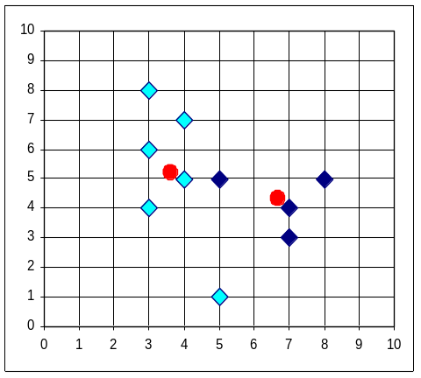


The K-Means Clustering Method
Example
The centroid points are shown for both clusters
Some points are shown as nearer to Second Cluster,
So re-grouping of Clusters

Slide 9
K-Means
Step 1: Begin with a decision on the value of k = number of clusters .
Step 2: Put any initial partition that classifies the data into k clusters. You may assign the training samples randomly,or systematically as the following:
1.Take the first k training sample as single-element clusters
2. Assign each of the remaining (N-k) training sample to the cluster with the nearest centroid. After each assignment, recompute the centroid of the gaining cluster.
Step 3: Take each sample in sequence and compute its distance from the centroid of each of the clusters. If a sample is not currently in the cluster with the closest centroid, switch this sample to that cluster and update the centroid of the cluster gaining the new sample and the cluster losing the sample.
Step 4 . Repeat step 3 until convergence is achieved, that is until a pass through the training sample causes no new assignments

Slide 10

How the K-Mean Clustering algorithm works?

Slide 11
K-Means: Measure of Similarity
Simply speaking k-means clustering is an algorithm to classify or to group the objects based on attributes/features into K number of group.
K is positive integer number.
The grouping is done by minimizing the sum of squares of distances between data and the corresponding cluster centroid.
There are other distance measures also considered for ;
  Distance measures

Slide 12

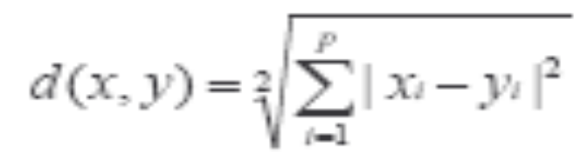
Common Distance measures:
Distance measure will determine how the similarity of two elements is calculated and it will influence the shape of the clusters.
They include:
1. The Euclidean distance (also called 2-norm distance) is given by:
2. The Manhattan distance (also called taxicab norm or 1-norm) is given by:

Slide 13
The K-Means Clustering Method
For Given k=3, the k-means algorithm is implemented in 4 steps:
  Partition objects into 3 nonempty subsets by taking 03 initial objects as 3 initial cluster centers, by assigning each object to a cluster based on the cluster center to which it is nearest
  Compute 03 seed points as the centroids of the clusters of the current partition. The centroid is the center (mean point) of the cluster.
  Assign each object to the cluster with the nearest seed point. This kind of grouping will update the Cluster centers.(Mean value of each cluster is recalculated based on the objects in the cluster)
  Go back to Step 2, stop when no more new assignment.

Slide 14
Comments on the K-Means Method
Strength
  Relatively efficient: O(tkn), where n is # objects, k is # clusters, and t is # iterations. Normally, k, t << n.
  Often terminates at a local optimum. The global optimum may be found using techniques such as: deterministic annealing and genetic algorithms
Weakness
  Applicable only when mean is defined, then what about categorical data?
  Need to specify k, the number of clusters, in advance
  Unable to handle noisy data and outliers
  Not suitable to discover clusters with non-convex shapes

Slide 15
Clustering
What is a good Clustering ?
Similarity / dissimilarity metrics for Clustering?
Major Clustering Approaches
  Partitioning methods
  Hierarchical methods
  Density based methods
Outlier Analysis
    What is outlier ?
    Why & How ?

Slide 16
What Is Good Clustering?
A good clustering method will produce high quality clusters with
  high intra-class similarity
  low inter-class similarity
The quality of a clustering result depends on both the similarity measure used by the method and its implementation.
The quality of a clustering method is also measured by its ability to discover some or all of the hidden patterns.

Slide 17
Typical Alternatives to Calculate the Distance between Clusters
Single link: smallest distance between an element in one cluster and an element in the other, i.e., dis(K_{i}, K_{j}) = min(t_{ip}, t_{jq})
Complete link: largest distance between an element in one cluster and an element in the other, i.e., dis(K_{i}, K_{j}) = max(t_{ip}, t_{jq})
Average: avg distance between an element in one cluster and an element in the other, i.e., dis(K_{i}, K_{j}) = avg(t_{ip}, t_{jq})
Centroid: distance between the centroids of two clusters, i.e., dis(K_{i}, K_{j}) = dis(C_{i}, C_{j})
Medoid: distance between the medoids of two clusters, i.e., dis(K_{i}, K_{j}) = dis(M_{i}, M_{j})
  Medoid: one chosen, centrally located object in the cluster
Data Mining: Concepts and Techniques

Slide 18
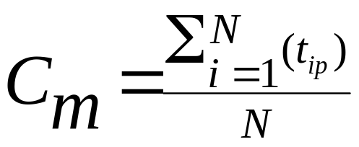
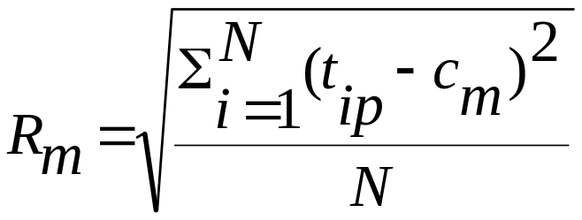

Centroid, Radius and Diameter of a Cluster (for numerical data sets)
Centroid: the “middle” of a cluster
Radius: square root of average distance from any point of the cluster to its centroid
Diameter: square root of average mean squared distance between all pairs of points in the cluster

Slide 19
General Applications of Clustering
Pattern Recognition
Spatial Data Analysis
  create thematic maps in GIS by clustering feature spaces
  detect spatial clusters and explain them in spatial data mining
Image Processing
Economic Science (especially market research)
WWW
  Document classification
  Cluster Weblog data to discover groups of similar access patterns
Data Mining: Concepts and Techniques

Slide 20
Examples of Clustering Applications
Marketing: Help marketers discover distinct groups in their customer bases, and then use this knowledge to develop targeted marketing programs
Land use: Identification of areas of similar land use in an earth observation database
Insurance: Identifying groups of motor insurance policy holders with a high average claim cost
City-planning: Identifying groups of houses according to their house type, value, and geographical location
Earth-quake studies: Observed earth quake epicenters should be clustered along continent faults
Data Mining: Concepts and Techniques

Slide 21
Requirements of Clustering in Data Mining
Scalability
Ability to deal with different types of attributes
Discovery of clusters with arbitrary shape
Minimal requirements for domain knowledge to determine input parameters
Able to deal with noise and outliers
Insensitive to order of input records
High dimensionality
Incorporation of user-specified constraints
Interpretability and usability

Slide 22
Major Clustering Approaches
Partitioning algorithms: Construct various partitions and then evaluate them by some criterion
Hierarchy algorithms: Create a hierarchical decomposition of the set of data (or objects) using some criterion
  Agglomerative or Divisive
Density-based: based on connectivity & density functions
Grid-based: based on a multiple-level granularity structure
Model-based: A model is hypothesized for each of the clusters and the idea is to find the best fit of that model to each other
Outlier Discovery:
Data Mining: Concepts and Techniques

Slide 23
Partitioning Algorithms: Basic Concept
Partitioning method: Construct a partition of a database D of n objects into a set of k clusters
Given a k, find a partition of k clusters that optimizes the chosen partitioning criterion
  Global optimal: exhaustively enumerate all partitions
  Heuristic methods: k-means and k-medoids algorithms
  k-means (MacQueen’67): Each cluster is represented by the center of the cluster
  k-medoids or PAM (Partition around medoids) (Kaufman & Rousseeuw’87): Each cluster is represented by one of the objects in the cluster

Slide 24

Variations of the K-Means Method
A few variants of the k-means which differ in
  Selection of the initial k means
  Dissimilarity calculations
  Strategies to calculate cluster means
Handling categorical data: k-modes (Huang’98)
  Replacing means of clusters with modes. Why?
  Using new dissimilarity measures to deal with categorical objects
  Using a frequency-based method to update modes of clusters
  A mixture of categorical and numerical data: k-prototype method

Slide 25
Mode
In statistics, the mode is the value that occurs the most frequently in a data set or a probability distribution.
  In some fields, notably education, sample data are often called scores, and the sample mode is known as the modal score.
Like the statistical mean and the median, the mode is a way of capturing important information about a random variable or a population in a single quantity.
The mode is in general different from the mean and median, and may be very different for strongly skewed distributions.
The mode is not necessarily unique, since the same maximum frequency may be attained at different values. The most ambiguous case occurs in uniform distributions, wherein all values are equally likely.

Slide 26
What Is the Problem of the K-Means Method?
The k-means algorithm is sensitive to outliers !
  Since an object with an extremely large value may substantially distort the distribution of the data.
  Consider 06 points in 1-D space, {1,2,3,8,9,10 and 25}
  {1,2,3} and {8,9,10,25} looks like two clusters
  Means of the first cluster being 2 while {8,9,10,25} will have mean as 13.
  In fact 25 being an Outlier is disturbing the distribution.
Instead of taking means as reference point, we can pick actual object representational object per cluster !
  Principle of minimizing an object with Sum of the dissimilarities between each object p and corresponding representational object is basis of k-Medoid method.
Data Mining: Concepts and Techniques

Slide 27
What Is the Problem of the K-Means Method?
K-Medoids: Instead of taking the mean value of the object in a cluster as a reference point, medoids can be used, which is the most centrally located object in a cluster.
Each remaining object is clustered with the representative object to which it is most similar.
The partitioning method is then performed based on the principle of minimizing the sum of the dissimilarities between each object and its corresponding reference point.
10
10
9
9
8
8
7
7
6
6
5
5
4
4
3
3
2
2
1
1
0
0
0
1
2
3
4
5
6
Data Mining: Concepts and Techniques
0
1
2
3
4
5
6
7
8
9
10
7
8
9
10

Slide 28
The K-Medoids Clustering Method
Find representative objects, called medoids, in clusters
PAM (Partitioning Around Medoids, 1987)
  starts from an initial set of medoids and iteratively replaces one of the medoids by one of the non-medoids if it improves the total distance of the resulting clustering
  PAM works effectively for small data sets, but does not scale well for large data sets
CLARA (Kaufmann & Rousseeuw, 1990)
CLARANS (Ng & Han, 1994): Randomized sampling
Focusing + spatial data structure (Ester et al., 1995)
Data Mining: Concepts and Techniques

Slide 29

A Typical K-Medoids Algorithm (PAM)
Total Cost = 20
10
9
8
Arbitrary choose k object as initial medoids
Assign each remaining object to nearest medoids
7
6
5
4
3
2
1
0
0
1
2
3
4
5
6
7
8
9
10
K=2
Randomly select a nonmedoid object,O_{ramdom}
Total Cost = 26
Do loop
Until no change
10
10
9
Compute total cost of swapping
9
Swapping O and O_{ramdom}
If quality is improved.
8
8
7
7
6
6
5
5
4
4
3
3
2
2
1
1
0
Data Mining: Concepts and Techniques
0
1
2
3
4
5
6
7
8
9
10
0
0
1
2
3
4
5
6
7
8
9
10

Slide 30
PAM (Partitioning Around Medoids) (1987)
PAM (Kaufman and Rousseeuw, 1987), built in Splus
Use real object to represent the cluster
  Select k representative objects arbitrarily
  For each pair of non-selected object h and selected object i, calculate the total swapping cost TC_{ih}
  For each pair of i and h,
    If TC_{ih} < 0, i is replaced by h
    Then assign each non-selected object to the most similar representative object
  repeat steps 2-3 until there is no change
Data Mining: Concepts and Techniques

Slide 31
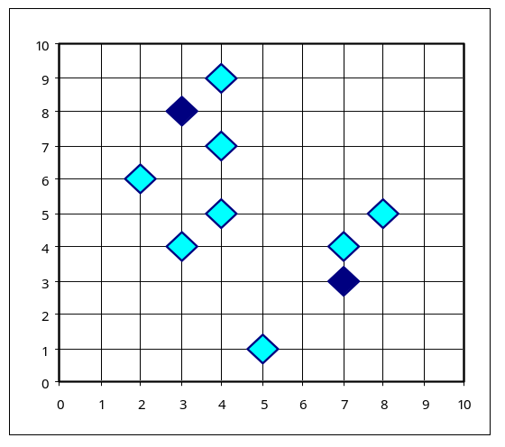
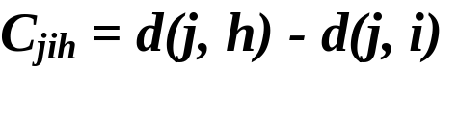

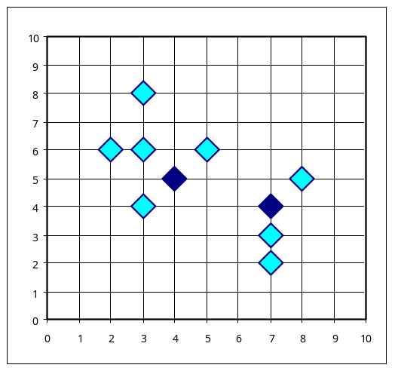
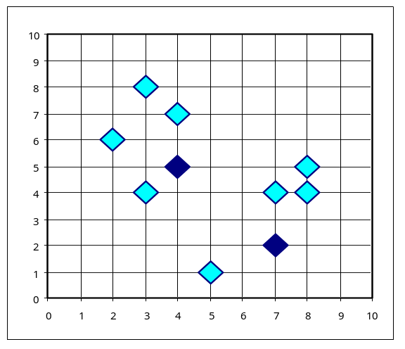


PAM Clustering: Total swapping cost TC_{ih}=∑_{j}C_{jih}
t
j
t
j
i
h
h
i
h
j
i
i
t
h
j
t
Data Mining: Concepts and Techniques

Slide 32
What Is the Problem with PAM?
Pam is more robust than k-means in the presence of noise and outliers because a medoid is less influenced by outliers or other extreme values than a mean
Pam works efficiently for small data sets but does not scale well for large data sets.
  O(k(n-k)² ) for each iteration
where n is # of data,k is # of clusters
Sampling based method,
CLARA(Clustering LARge Applications)
Data Mining: Concepts and Techniques

Slide 33
CLARA (Clustering Large Applications) (1990)
CLARA (Kaufmann and Rousseeuw in 1990)
  Built in statistical analysis packages, such as S+
It draws multiple samples of the data set, applies PAM on each sample, and gives the best clustering as the output
Strength: deals with larger data sets than PAM
Weakness:
  Efficiency depends on the sample size
  A good clustering based on samples will not necessarily represent a good clustering of the whole data set if the sample is biased
Data Mining: Concepts and Techniques

Slide 34
The K-Medoids Clustering Method
Find representative objects, called medoids, in clusters
PAM (Partitioning Around Medoids, 1987)
CLARA (Kaufmann & Rousseeuw, 1990)
CLARANS (Ng & Han, 1994): Randomized sampling
Focusing + spatial data structure (Ester et al., 1995)
Data Mining: Concepts and Techniques

Slide 35
CLARANS (“Randomized” CLARA)
CLARANS (A Clustering Algorithm based on Randomized Search) (Ng and Han’94)
CLARANS draws sample of neighbors dynamically
The clustering process can be presented as searching a graph where every node is a potential solution, that is, a set of k medoids
If the local optimum is found, CLARANS starts with new randomly selected node in search for a new local optimum
It is more efficient and scalable than both PAM and CLARA
Focusing techniques and spatial access structures may further improve its performance (Ester et al.’95)
Data Mining: Concepts and Techniques

Slide 36
Hierarchical Clustering
In some situation we may want to partition our data into groups at different levels such as a hierarchy.
  A hierarchical clustering methods works by grouping data objects into “tree” of clusters.
  Representing data objects in hierarchy is useful for data visualization and summarization.
This method does not require the number of clusters k as an input, but needs a termination condition.

Slide 37
Hierarchical Clustering
Uses hierarchical decomposition of the given distance matrix as clustering criteria.
Can be classified as being either agglomerative or divisive, based on how the hierarchical decomposition is formed.
  Agglomerative approach
  Divisive Approach
This method does not require the number of clusters k as an input, but needs a termination condition.

Slide 38
Dendrogram: Shows How the Clusters are Merged
  A tree structure called a dendogram is commonly used to represent the process of hierarchical clustering.
  Decompose data objects into a several levels of nested partitioning (tree of clusters), called a dendrogram.
  A clustering of the data objects is obtained by cutting the dendrogram at the desired level, then each connected component forms a cluster.
Data Mining: Concepts and Techniques

Slide 39
Agglomerative Approach
Also known as Bottom Up strategy, starts by placing each object in its own cluster and then merges these atomic clusters into larger and larger clusters,
  until all of the objects are in a single cluster
Or
  Until certain termination conditions are satisfied .
Most hierarchical clustering methods belong to this category.
They differ only in their definition of inter-cluster similarity

Slide 40
Agglomerative Nesting to a data set of 5 objects {a,b,c,d,e}.
Initially each object is placed into a cluster of its own.
The clusters are then merged (based on some criterion) in step-by-step manner 1
Agglomerative
(AGNES)
Step 0
Step 1
Step 2
Step 3
Step 4
a
a b
b
a b c d e
c
c d e
d
d e
e
divisive
(DIANA)
Step 4
Step 3
Step 2
Step 1
Step 0
Data Mining: Concepts and Techniques

Slide 41

AGNES (Agglomerative Nesting)
Introduced in Kaufmann and Rousseeuw (1990)
Implemented in statistical analysis packages, e.g., Splus
Use the Single-Link method and the dissimilarity matrix.
Merge nodes that have the least dissimilarity
Go on in a non-descending fashion
Eventually all nodes belong to the same cluster
Data Mining: Concepts and Techniques

Slide 42
Divisive Analysis Clustering
Use distance matrix as clustering criteria. This method does not require the number of clusters k as an input, but needs a termination condition
Step 0
Step 1
Step 2
Step 3
Step 4
a
a b
b
a b c d e
c
c d e
d
d e
e
Divisive
(DIANA)
Step 4
Step 3
Step 2
Step 1
Step 0
Data Mining: Concepts and Techniques

Slide 43
DIANA (Divisive Analysis)
Introduced in Kaufmann and Rousseeuw (1990)
Implemented in statistical analysis packages, e.g., Splus
Inverse order of AGNES
Eventually each node forms a cluster on its own
Data Mining: Concepts and Techniques

Slide 44
Recent Hierarchical Clustering Methods
Major weakness of agglomerative clustering methods
  do not scale well: time complexity of at least O(n²), where n is the number of total objects
  can never undo what was done previously
Integration of hierarchical with distance-based clustering
  BIRCH (1996): uses CF-tree and incrementally adjusts the quality of sub-clusters
  ROCK (1999): clustering categorical data by neighbor and link analysis
  CHAMELEON (1999): hierarchical clustering using dynamic modeling
Data Mining: Concepts and Techniques

Slide 45
BIRCH (1996)
Birch: Balanced Iterative Reducing and Clustering using Hierarchies (Zhang, Ramakrishnan & Livny, SIGMOD’96)
Incrementally construct a CF (Clustering Feature) tree, a hierarchical data structure for multiphase clustering
  Phase 1: scan DB to build an initial in-memory CF tree (a multi-level compression of the data that tries to preserve the inherent clustering structure of the data)
  Phase 2: use an arbitrary clustering algorithm to cluster the leaf nodes of the CF-tree
Scales linearly: finds a good clustering with a single scan and improves the quality with a few additional scans
Weakness: handles only numeric data, and sensitive to the order of the data record.
Data Mining: Concepts and Techniques

Slide 46
Clustering Feature Vector in BIRCH
Clustering Feature: CF = (N, LS, SS)
N: Number of data points
LS: ∑^{N}_{i=1}=X_{i}
SS: ∑^{N}_{i=1}=X_{i}²
CF = (5, (16,30),(54,190))
(3,4)
(2,6)
(4,5)
(4,7)
(3,8)
Data Mining: Concepts and Techniques

Slide 47
Clustering Approaches
Partitioning algorithms :
  Given a database D of n objects, a partitioning method constructs a set of k clusters.
  Where each partition is a cluster and k< =n.
      Each group must contain atleast one object
      Each object must belong to exactly one group.
Given a k, find a partition of k clusters that optimizes the chosen partitioning criterion

Slide 48
Hierarchical methods
Creates hierarchical decomposition of the given set of data objects.
Agglomerative approach starts with each object forming a separate group, it successively merges the objects into groups until all the objects are merged into one or till termination condition is fulfilled.
Divisive approach starts with all the data items into one and in successive iteration the data objects are splited into smaller cluster until all the objects are grouped as each being one cluster or till termination condition is fulfilled.

Slide 49
Partitioning Algorithms: Basic Concept
Partitioning method: Construct a partition of a database D of n objects into a set of k clusters
Given a k, find a partition of k clusters that optimizes the chosen partitioning criterion
  Global optimal: exhaustively enumerate all partitions
  Heuristic methods: k-means and k-medoids algorithms
  k-means (MacQueen’67): Each cluster is represented by the center of the cluster
  k-medoids or PAM (Partition around medoids) (Kaufman & Rousseeuw’87): Each cluster is represented by one of the objects in the cluster

Slide 50
Cluster Analysis
What is Cluster Analysis?
Types of Data in Cluster Analysis
A Categorization of Major Clustering Methods
Partitioning Methods
Hierarchical Methods
Density-Based Methods
Grid-Based Methods
Model-Based Methods
Clustering High-Dimensional Data
Constraint-Based Clustering
Outlier Analysis
Summary
Data Mining: Concepts and Techniques

Slide 51
Hierarchical Clustering
Use distance matrix as clustering criteria. This method does not require the number of clusters k as an input, but needs a termination condition
Step 0
Step 1
Step 2
Step 3
Step 4
agglomerative
(AGNES)
a
a b
b
a b c d e
c
c d e
d
d e
e
divisive
(DIANA)
Step 4
Step 3
Step 2
Step 1
Step 0
Data Mining: Concepts and Techniques

Slide 52
AGNES (Agglomerative Nesting)
Introduced in Kaufmann and Rousseeuw (1990)
Implemented in statistical analysis packages, e.g., Splus
Use the Single-Link method and the dissimilarity matrix.
Merge nodes that have the least dissimilarity
Go on in a non-descending fashion
Eventually all nodes belong to the same cluster
Data Mining: Concepts and Techniques

Slide 53
DIANA (Divisive Analysis)
Introduced in Kaufmann and Rousseeuw (1990)
Implemented in statistical analysis packages, e.g., Splus
Inverse order of AGNES
Eventually each node forms a cluster on its own
Data Mining: Concepts and Techniques

Slide 54
Recent Hierarchical Clustering Methods
Major weakness of agglomerative clustering methods
  do not scale well: time complexity of at least O(n²), where n is the number of total objects
  can never undo what was done previously
Integration of hierarchical with distance-based clustering
  BIRCH (1996): uses CF-tree and incrementally adjusts the quality of sub-clusters
  ROCK (1999): clustering categorical data by neighbor and link analysis
  CHAMELEON (1999): hierarchical clustering using dynamic modeling
Data Mining: Concepts and Techniques

Slide 55
BIRCH (1996)
Birch: Balanced Iterative Reducing and Clustering using Hierarchies (Zhang, Ramakrishnan & Livny, SIGMOD’96)
Incrementally construct a CF (Clustering Feature) tree, a hierarchical data structure for multiphase clustering
  Phase 1: scan DB to build an initial in-memory CF tree (a multi-level compression of the data that tries to preserve the inherent clustering structure of the data)
  Phase 2: use an arbitrary clustering algorithm to cluster the leaf nodes of the CF-tree
Scales linearly: finds a good clustering with a single scan and improves the quality with a few additional scans
Weakness: handles only numeric data, and sensitive to the order of the data record.
Data Mining: Concepts and Techniques

Slide 56
Clustering Feature Vector
Clustering Feature: CF = (N, LS, SS)
N: Number of data points
LS: ∑^{N}_{i=1}=X_{i}
SS: ∑^{N}_{i=1}=X_{i}²
CF = (5, (16,30),(54,190))
(3,4)
(2,6)
(4,5)
(4,7)
(3,8)

Slide 57
CF Tree
Root
B = 7
L = 6
CF₁
CF₂
CF₃
CF₆
child₁
child₂
child₃
child₆
Non-leaf node
CF₁
CF₂
CF₃
CF₅
child₁
child₂
child₃
child₅
Leaf node
Leaf node
prev
CF₁
CF₂
CF₆
next
prev
CF₁
CF₂
CF₄
next

Slide 58
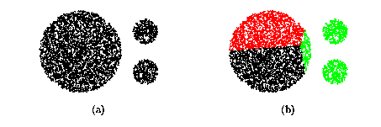
CURE (Clustering Using REpresentatives )
CURE: proposed by Guha, Rastogi & Shim, 1998
  Stops the creation of a cluster hierarchy if a level consists of k clusters
  Uses multiple representative points to evaluate the distance between clusters, adjusts well to arbitrary shaped clusters and avoids single-link effect

Slide 59
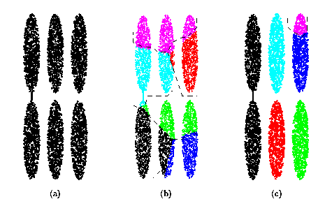
Drawbacks of Distance-Based Method
Drawbacks of square-error based clustering method
  Consider only one point as representative of a cluster
  Good only for convex shaped, similar size and density, and if k can be reasonably estimated

Slide 60
Cure: The Algorithm
  Draw random sample s.
  Partition sample to p partitions with size s/p
  Partially cluster partitions into s/pq clusters
  Eliminate outliers
    By random sampling
    If a cluster grows too slow, eliminate it.
  Cluster partial clusters.
  Label data in disk

Slide 61
Data Partitioning and Clustering
  s = 50
  p = 2
  s/p = 25
  s/pq = 5
y
y
y
x
y
y
x
x
x
x

Slide 62
Cure: Shrinking Representative Points
y
y
x
x
Shrink the multiple representative points towards the gravity center by a fraction of α.
Multiple representatives capture the shape of the cluster

Slide 63
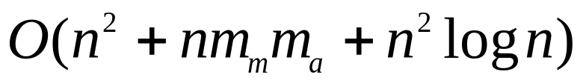

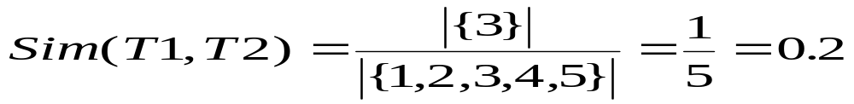
Clustering Categorical Data: ROCK
ROCK: Robust Clustering using linKs,
by S. Guha, R. Rastogi, K. Shim (ICDE’99).
  Use links to measure similarity/proximity
  Not distance based
  Computational complexity:
Basic ideas:
  Similarity function and neighbors:
    Let T₁ = {1,2,3}, T₂={3,4,5}

Slide 64
Rock: Algorithm
Links: The number of common neighbours for the two points.
Algorithm
  Draw random sample
  Cluster with links
  Label data in disk
{1,2,3}, {1,2,4}, {1,2,5}, {1,3,4}, {1,3,5}
{1,4,5}, {2,3,4}, {2,3,5}, {2,4,5}, {3,4,5}
3
{1,2,3} {1,2,4}

Slide 65
CHAMELEON
CHAMELEON: hierarchical clustering using dynamic modeling, by G. Karypis, E.H. Han and V. Kumar’99
Measures the similarity based on a dynamic model
  Two clusters are merged only if the interconnectivity and closeness (proximity) between two clusters are high relative to the internal interconnectivity of the clusters and closeness of items within the clusters
A two phase algorithm
  1. Use a graph partitioning algorithm: cluster objects into a large number of relatively small sub-clusters
  2. Use an agglomerative hierarchical clustering algorithm: find the genuine clusters by repeatedly combining these sub-clusters

Slide 66
Overall Framework of CHAMELEON
Construct
Sparse Graph
Partition the Graph
Data Set
Merge Partition
Final Clusters

Slide 67
Cluster Analysis
What is Cluster Analysis?
Types of Data in Cluster Analysis
A Categorization of Major Clustering Methods
Partitioning Methods
Hierarchical Methods
Density-Based Methods
Grid-Based Methods
Model-Based Clustering Methods
Outlier Analysis
Summary

Slide 68
Clustering
What is a good Clustering ?
Similarity / dissimilarity metrics for Clustering?
Major Clustering Approaches
  Partitioning methods
  Hierarchical methods
  Density based methods
Outlier Analysis
    What is outlier ?
    Why & How ?

Slide 69
Density-Based Clustering Methods
Clustering based on density (local cluster criterion), such as density-connected points
Major features:
  Discover clusters of arbitrary shape
  Handle noise
  One scan
  Need density parameters as termination condition
Several interesting studies:
  DBSCAN: Ester, et al. (KDD’96)
  OPTICS: Ankerst, et al (SIGMOD’99).
  DENCLUE: Hinneburg & D. Keim (KDD’98)
  CLIQUE: Agrawal, et al. (SIGMOD’98)

Slide 70
Density-Based Clustering: Background
Two parameters:
  Eps: Maximum radius of the neighbourhood
  MinPts: Minimum number of points in an Eps-neighbourhood of that point
N_{Eps}(p): {q belongs to D | dist(p,q) <= Eps}
Directly density-reachable: A point p is directly density-reachable from a point q wrt. Eps, MinPts if
  1) p belongs to N_{Eps}(q)
  2) core point condition:
  |N_{Eps} (q)| >= MinPts
p
MinPts = 5
Eps = 1 cm
q

Slide 71
Density-Based Clustering: Background (II)
Density-reachable:
  A point p is density-reachable from a point q wrt. Eps, MinPts if there is a chain of points p₁, …, p_{n}, p₁ = q, p_{n} = p such that p_{i+1} is directly density-reachable from p_{i}
Density-connected
  A point p is density-connected to a point q wrt. Eps, MinPts if there is a point o such that both, p and q are density-reachable from o wrt. Eps and MinPts.
p
p₁
q
p
q
o

Slide 72
DBSCAN: Density Based Spatial Clustering of Applications with Noise
Relies on a density-based notion of cluster: A cluster is defined as a maximal set of density-connected points
Discovers clusters of arbitrary shape in spatial databases with noise
Outlier
Border
Eps = 1cm
MinPts = 5
Core

Slide 73
DBSCAN: The Algorithm
  Arbitrary select a point p
  Retrieve all points density-reachable from p wrt Eps and MinPts.
  If p is a core point, a cluster is formed.
  If p is a border point, no points are density-reachable from p and DBSCAN visits the next point of the database.
  Continue the process until all of the points have been processed.

Slide 74
DBSCAN
It grows clusters according to the density of neighborhood objects.
It has found major applications in Spatial database, with varying population.
Complexity
DBSCAN visits each point of the database, possibly multiple times (e.g., as candidates to different clusters).
For practical considerations, however, the time complexity is mostly governed by the number of getNeighbors queries.
The complexity of DBSCAN is o(n*n) where n is no. of data objects
but if
an indexing structure is used then it is O(logn), is obtained.

Slide 75
DBSCAN
Advantages
DBScan does not require you to know the number of clusters in the data a priori, as opposed to k-means.
DBScan can find arbitrarily shaped clusters. It can even find clusters completely surrounded by (but not connected to) a different cluster. Due to the MinPts parameter, the so-called single-link effect (different clusters being connected by a thin line of points) is reduced.
DBScan requires just two parameters and is mostly insensitive to the ordering of the points in the database. (Only points sitting on the edge of two different clusters might swap cluster membership if the ordering of the points is changed, and the cluster assignment is unique only up to isomorphism.)

Slide 76
Disadvantages
DBSCAN can only result in a good clustering as good as its distance measure is in the function getNeighbors(P,epsilon).
The most common distance metric used is the euclidean distance measure. Especially for high-dimensional data, this distance metric can be rendered almost useless.
DBScan does not respond well to data sets with varying densities (called hierarchical data sets).
DBSCAN is sensitive to the two parameters-Eps and Minpts.
  Change in Eps and Minpts may lead to very different clusterings.

Slide 77



DBSCAN: Sensitive to Parameters
Data Mining: Concepts and Techniques

Slide 78
OPTICS
OPTICS (ordering points to identify the clustering structure) is an algorithm for finding clusters in spatial data.
Its basic idea is similar to DBSCAN, but it addresses one of DBSCAN's major weaknesses: the problem of detecting meaningful clusters in data of varying density.
In order to do so, the points of the database are (linearily) ordered such that points which are spatially closest become neighbors in the ordering.
Additionally, a special distance is stored for each point that represents the density that needs to be accepted for a cluster in order to have both points belong to the same cluster.

Slide 79
OPTICS: A Cluster-Ordering Method (1999)
OPTICS: Ordering Points To Identify the Clustering Structure
  Ankerst, Breunig, Kriegel, and Sander (SIGMOD’99)
  Produces a special order of the database wrt its density-based clustering structure
  This cluster-ordering contains info equiv to the density-based clusterings corresponding to a broad range of parameter settings
  Good for both automatic and interactive cluster analysis, including finding intrinsic clustering structure
  Can be represented graphically or using visualization techniques : DENDOGRAMS.
  Using a reachability-plot (a special kind of dendrogram), the hierarchical structure of the clusters can be obtained easily.
    It is a 2D plot, with the ordering of the points on the x-axis and the reachability distance on the y-axis. Since points belonging to a cluster have a low reachability distance to their nearest neighbor, the clusters show up as valleys in the reachability plot. The deeper the valley, the denser the cluster.

Slide 80
OPTICS: Some Extension from DBSCAN
Index-based:
    k = number of dimensions
    N = 20
    p = 75%
    M = N(1-p) = 5
  Complexity: O(kN²)
Core Distance
Reachability Distance
D
p1
o
p2
o
Max (core-distance (o), d (o, p))
r(p1, o) = 2.8cm. r(p2,o) = 4cm
MinPts = 5
ε = 3 cm

Slide 81


Reachability-distance
undefined
‘
Cluster-order
of the objects

Slide 82


Regionalisation
Regionalisation, a prominent problem from social geography, could be solved by a density based clustering algorithm for grouping spatial objects.
A typical task is to find spatially compact and dense regions of arbitrary shape with a homogeneous internal distribution of social variables.

Slide 83
Density-Based Clustering: Applications in Regionalization
Grouping a set of homogeneous spatial units to compose a larger region can be useful for sampling procedures as well as many applications, e.g., direct mailing.
It would be helpful to have specific purpose regions, depending on the kind of homogeneity one is interested in.
In our research paper, we propose an algorithm combining the ‘spatial density’ clustering approach and a covariance-based method to inductively find spatially dense and non-spatially homogeneous clusters of arbitrary shape.
Data Mining: Concepts and Techniques

Slide 84
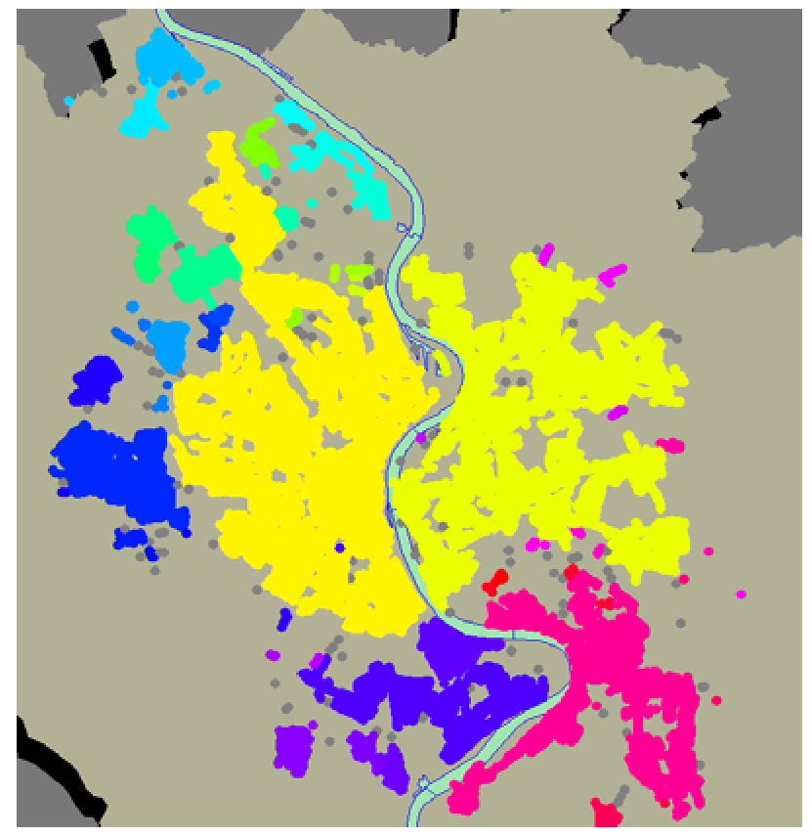
Clustering of Cologne City geographical region using DBSCAN

Slide 85
DENCLUE: using density functions
DENsity-based CLUstEring by Hinneburg & Keim (KDD’98)
Major features
  Solid mathematical foundation
  Good for data sets with large amounts of noise
  Allows a compact mathematical description of arbitrarily shaped clusters in high-dimensional data sets
  Significant faster than existing algorithm (faster than DBSCAN by a factor of up to 45)
  But needs a large number of parameters

Slide 86
Denclue: Technical Essence
Uses grid cells but only keeps information about grid cells that do actually contain data points and manages these cells in a tree-based access structure.
Influence function: describes the impact of a data point within its neighborhood.
Overall density of the data space can be calculated as the sum of the influence function of all data points.
Clusters can be determined mathematically by identifying density attractors.
Density attractors are local maximal of the overall density function.

Slide 87
What Is Outlier Discovery?
What are outliers?
  The set of objects are considerably dissimilar from the remainder of the data
  Example: Sports: Michael Jordon, Sachin Tendulkar, ...
Problem
  Why: Somebody’s noise can be Alarm for Other
  How: Find top n outlier points
Applications:
  Anomaly Detection:
    Credit card fraud detection
    Telecom fraud detection
    Network Fault occurrences
  Medical analysis
  Customer segmentation

Slide 88
Outlier Mining
Given a set of n data points or objects, and k, the expected number of outliers,
Find the top k objects that are considerably dissimilar, exceptional, or inconsistent with respect to the remaining data.
The outlier mining problem can be viewed as two subproblems;
  Define what data can be considered as inconsistent in a given data set, and
  Find an efficient method to mine the outliers so defined

Slide 89

Outlier Discovery: Statistical Approaches
Assume a model underlying distribution that generates data set (e.g. normal distribution)
Use discordancy tests depending on
  data distribution
  distribution parameter (e.g., mean, variance)
  number of expected outliers
Drawbacks
  most tests are for single attribute
  In many cases, data distribution may not be known

Slide 90
Outlier Discovery: Distance-Based Approach
Introduced to counter the main limitations imposed by statistical methods
  We need multi-dimensional analysis without knowing data distribution.
Distance-based outlier: A DB(p, D)-outlier is an object O in a dataset T such that at least a fraction p of the objects in T lies at a distance greater than D from O
Algorithms for mining distance-based outliers
  Index-based algorithm
  Nested-loop algorithm
  Cell-based algorithm

Slide 91
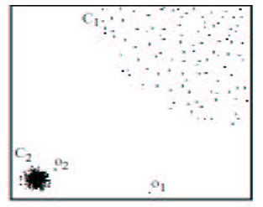
Density-Based Local Outlier Detection
Distance-based outlier detection is based on global distance distribution
It encounters difficulties to identify outliers if data is not uniformly distributed
Ex. C₁ contains 400 loosely distributed points, C₂ has 100 tightly condensed points, 2 outlier points o₁, o₂
Distance-based method cannot identify o₂ as an outlier
Need the concept of local outlier
Local outlier factor (LOF)
  Assume outlier is not crisp
  Each point has a LOF
Data Mining: Concepts and Techniques

Slide 92
Outlier Discovery: Deviation-Based Approach
Identifies outliers by examining the main characteristics of objects in a group
Objects that “deviate” from this description are considered outliers
Sequential exception technique
  simulates the way in which humans can distinguish unusual objects from among a series of supposedly like objects
OLAP data cube technique
  uses data cubes to identify regions of anomalies in large multidimensional data
Data Mining: Concepts and Techniques

Slide 93
Outlier Discovery: Deviation-Based Approach
Identifies outliers by examining the main characteristics of objects in a group
Objects that “deviate” from this description are considered outliers
sequential exception technique
  simulates the way in which humans can distinguish unusual objects from among a series of supposedly like objects
OLAP data cube technique
  uses data cubes to identify regions of anomalies in large multidimensional data

Slide 94
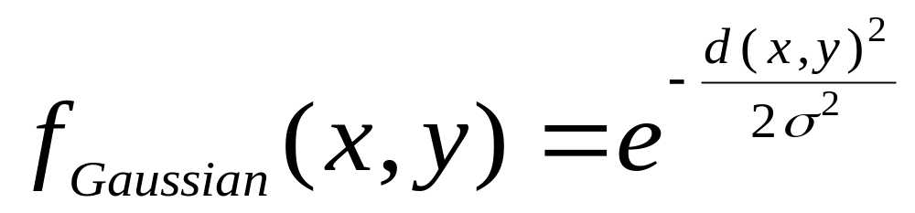
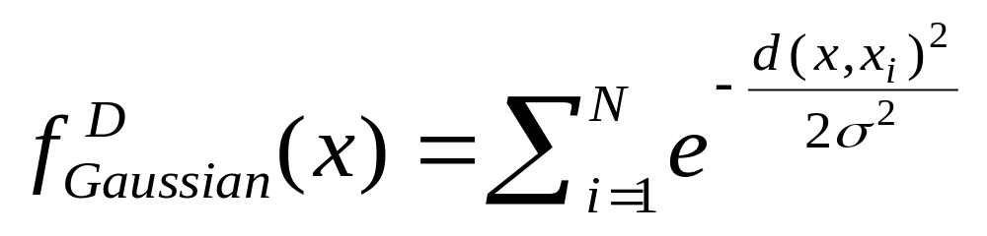

Gradient: The steepness of a slope
Example

Slide 95



Density Attractor

Slide 96

Center-Defined and Arbitrary

Slide 97
Chapter 8. Cluster Analysis
What is Cluster Analysis?
Types of Data in Cluster Analysis
A Categorization of Major Clustering Methods
Partitioning Methods
Hierarchical Methods
Density-Based Methods
Grid-Based Methods
Model-Based Clustering Methods
Outlier Analysis
Summary

Slide 98
Grid-Based Clustering Method
Using multi-resolution grid data structure
Several interesting methods
  STING (a STatistical INformation Grid approach) by Wang, Yang and Muntz (1997)
  WaveCluster by Sheikholeslami, Chatterjee, and Zhang (VLDB’98)
    A multi-resolution clustering approach using wavelet method
  CLIQUE: Agrawal, et al. (SIGMOD’98)

Slide 99
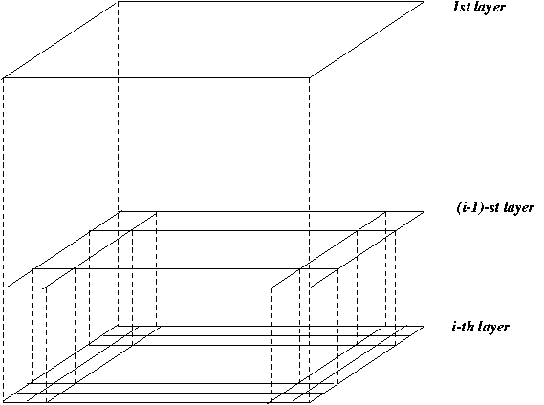
STING: A Statistical Information Grid Approach
Wang, Yang and Muntz (VLDB’97)
The spatial area area is divided into rectangular cells
There are several levels of cells corresponding to different levels of resolution

Slide 100
STING: A Statistical Information Grid Approach (2)
  Each cell at a high level is partitioned into a number of smaller cells in the next lower level
  Statistical info of each cell is calculated and stored beforehand and is used to answer queries
  Parameters of higher level cells can be easily calculated from parameters of lower level cell
    count, mean, s, min, max
    type of distribution—normal, uniform, etc.
  Use a top-down approach to answer spatial data queries
  Start from a pre-selected layer—typically with a small number of cells
  For each cell in the current level compute the confidence interval

Slide 101
STING: A Statistical Information Grid Approach (3)
  Remove the irrelevant cells from further consideration
  When finish examining the current layer, proceed to the next lower level
  Repeat this process until the bottom layer is reached
  Advantages:
    Query-independent, easy to parallelize, incremental update
    O(K), where K is the number of grid cells at the lowest level
  Disadvantages:
    All the cluster boundaries are either horizontal or vertical, and no diagonal boundary is detected

Slide 102
WaveCluster (1998)
Sheikholeslami, Chatterjee, and Zhang (VLDB’98)
A multi-resolution clustering approach which applies wavelet transform to the feature space
  A wavelet transform is a signal processing technique that decomposes a signal into different frequency sub-band.
Both grid-based and density-based
Input parameters:
  # of grid cells for each dimension
  the wavelet, and the # of applications of wavelet transform.

Slide 103
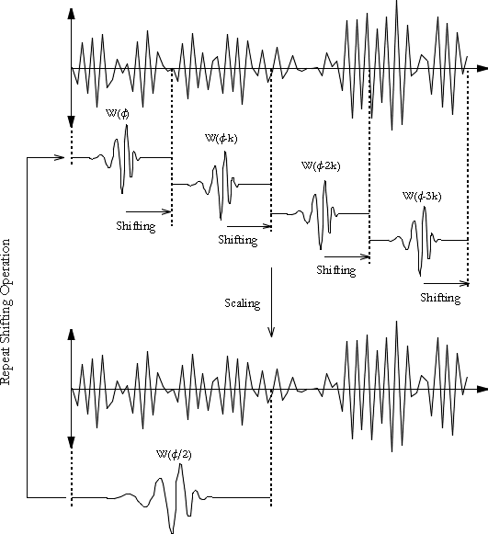
What is Wavelet (1)?

Slide 104
WaveCluster (1998)
How to apply wavelet transform to find clusters
  Summaries the data by imposing a multidimensional grid structure onto data space
  These multidimensional spatial data objects are represented in a n-dimensional feature space
  Apply wavelet transform on feature space to find the dense regions in the feature space
  Apply wavelet transform multiple times which result in clusters at different scales from fine to coarse

Slide 105


What Is Wavelet (2)?

Slide 106

Quantization

Slide 107

Transformation

Slide 108
WaveCluster (1998)
Why is wavelet transformation useful for clustering
  Unsupervised clustering
  It uses hat-shape filters to emphasize region where points cluster, but simultaneously to suppress weaker information in their boundary
  Effective removal of outliers
  Multi-resolution
  Cost efficiency
Major features:
  Complexity O(N)
  Detect arbitrary shaped clusters at different scales
  Not sensitive to noise, not sensitive to input order
  Only applicable to low dimensional data

Slide 109
CLIQUE (Clustering In QUEst)
Agrawal, Gehrke, Gunopulos, Raghavan (SIGMOD’98).
Automatically identifying subspaces of a high dimensional data space that allow better clustering than original space
CLIQUE can be considered as both density-based and grid-based
  It partitions each dimension into the same number of equal length interval
  It partitions an m-dimensional data space into non-overlapping rectangular units
  A unit is dense if the fraction of total data points contained in the unit exceeds the input model parameter
  A cluster is a maximal set of connected dense units within a subspace

Slide 110
CLIQUE: The Major Steps
Partition the data space and find the number of points that lie inside each cell of the partition.
Identify the subspaces that contain clusters using the Apriori principle
Identify clusters:
  Determine dense units in all subspaces of interests
  Determine connected dense units in all subspaces of interests.
Generate minimal description for the clusters
  Determine maximal regions that cover a cluster of connected dense units for each cluster
  Determination of minimal cover for each cluster

Slide 111
Salary (10,000)
Vacation(week)
7
7
6
6
5
5
4
4
3
3
2
2
1
1
0
age
0
age
20
30
40
50
60
20
30
40
50
60
τ = 3
Vacation
Salary
30
50
age

Slide 112
Strength and Weakness of CLIQUE
Strength
  It automatically finds subspaces of the highest dimensionality such that high density clusters exist in those subspaces
  It is insensitive to the order of records in input and does not presume some canonical data distribution
  It scales linearly with the size of input and has good scalability as the number of dimensions in the data increases
Weakness
  The accuracy of the clustering result may be degraded at the expense of simplicity of the method

Slide 113
Chapter 8. Cluster Analysis
What is Cluster Analysis?
Types of Data in Cluster Analysis
A Categorization of Major Clustering Methods
Partitioning Methods
Hierarchical Methods
Density-Based Methods
Grid-Based Methods
Model-Based Clustering Methods
Outlier Analysis
Summary

Slide 114
Model-Based Clustering Methods
Attempt to optimize the fit between the data and some mathematical model
Statistical and AI approach
  Conceptual clustering
    A form of clustering in machine learning
    Produces a classification scheme for a set of unlabeled objects
    Finds characteristic description for each concept (class)
  COBWEB (Fisher’87)
    A popular a simple method of incremental conceptual learning
    Creates a hierarchical clustering in the form of a classification tree
    Each node refers to a concept and contains a probabilistic description of that concept

Slide 115

COBWEB Clustering Method
A classification tree

Slide 116
More on Statistical-Based Clustering
Limitations of COBWEB
  The assumption that the attributes are independent of each other is often too strong because correlation may exist
  Not suitable for clustering large database data – skewed tree and expensive probability distributions
CLASSIT
  an extension of COBWEB for incremental clustering of continuous data
  suffers similar problems as COBWEB
AutoClass (Cheeseman and Stutz, 1996)
  Uses Bayesian statistical analysis to estimate the number of clusters
  Popular in industry

Slide 117
Other Model-Based Clustering Methods
Neural network approaches
  Represent each cluster as an exemplar, acting as a “prototype” of the cluster
  New objects are distributed to the cluster whose exemplar is the most similar according to some dostance measure
Competitive learning
  Involves a hierarchical architecture of several units (neurons)
  Neurons compete in a “winner-takes-all” fashion for the object currently being presented

Slide 118
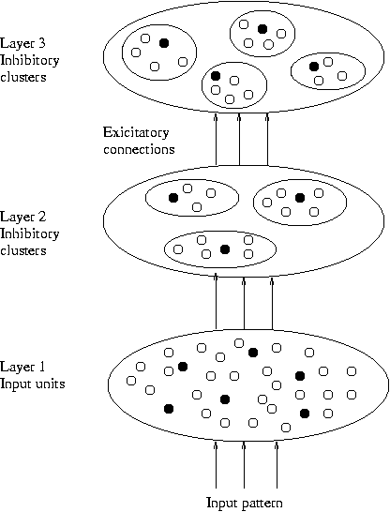
Model-Based Clustering Methods

Slide 119
Self-organizing feature maps (SOMs)
Clustering is also performed by having several units competing for the current object
The unit whose weight vector is closest to the current object wins
The winner and its neighbors learn by having their weights adjusted
SOMs are believed to resemble processing that can occur in the brain
Useful for visualizing high-dimensional data in 2- or 3-D space

Slide 120
Cluster Analysis
What is Cluster Analysis?
Types of Data in Cluster Analysis
A Categorization of Major Clustering Methods
Partitioning Methods
Hierarchical Methods
Density-Based Methods
Grid-Based Methods
Model-Based Clustering Methods
Outlier Analysis
Summary

Slide 121
Cluster Analysis
What is Cluster Analysis?
Types of Data in Cluster Analysis
A Categorization of Major Clustering Methods
Partitioning Methods
Hierarchical Methods
Density-Based Methods
Grid-Based Methods
Model-Based Clustering Methods
Outlier Analysis
Summary

Slide 122
Problems and Challenges
Considerable progress has been made in scalable clustering methods
  Partitioning: k-means, k-medoids, CLARANS
  Hierarchical: BIRCH, CURE
  Density-based: DBSCAN, CLIQUE, OPTICS
  Grid-based: STING, WaveCluster
  Model-based: Autoclass, Denclue, Cobweb
Current clustering techniques do not address all the requirements adequately
Constraint-based clustering analysis: Constraints exist in data space (bridges and highways) or in user queries

Slide 123
Constraint-Based Clustering Analysis
Clustering analysis: less parameters but more user-desired constraints, e.g., an ATM allocation problem

Slide 124
Summary
Cluster analysis groups objects based on their similarity and has wide applications
Measure of similarity can be computed for various types of data
Clustering algorithms can be categorized into partitioning methods, hierarchical methods, density-based methods, grid-based methods, and model-based methods
Outlier detection and analysis are very useful for fraud detection, etc. and can be performed by statistical, distance-based or deviation-based approaches
There are still lots of research issues on cluster analysis, such as constraint-based clustering

Slide 125
Bibliography
J. Han and M. Kamber. Data Mining – Concepts and Techniques. 2001. Morgan Kaufmann.
M. Kantardzic. Data Mining – Concepts, Models, Methods, and Algorithms. 2003. IEEE.
M. H. Dunham. Data Mining – Introductory and Advanced Topics.
I.H. Witten and E. Frank. Data Mining – Practical Machine Learning Tools and Techniques with Java Implementations. 2000. Morgan Kaufmann.
Ranjana Vyas- Ph.D. Thesis “ Exploring some data mining techniques for DSS through efficient Knowledge Management” 2008.
Fall 2003
CSE 494 by H. Liu

